Slide 1

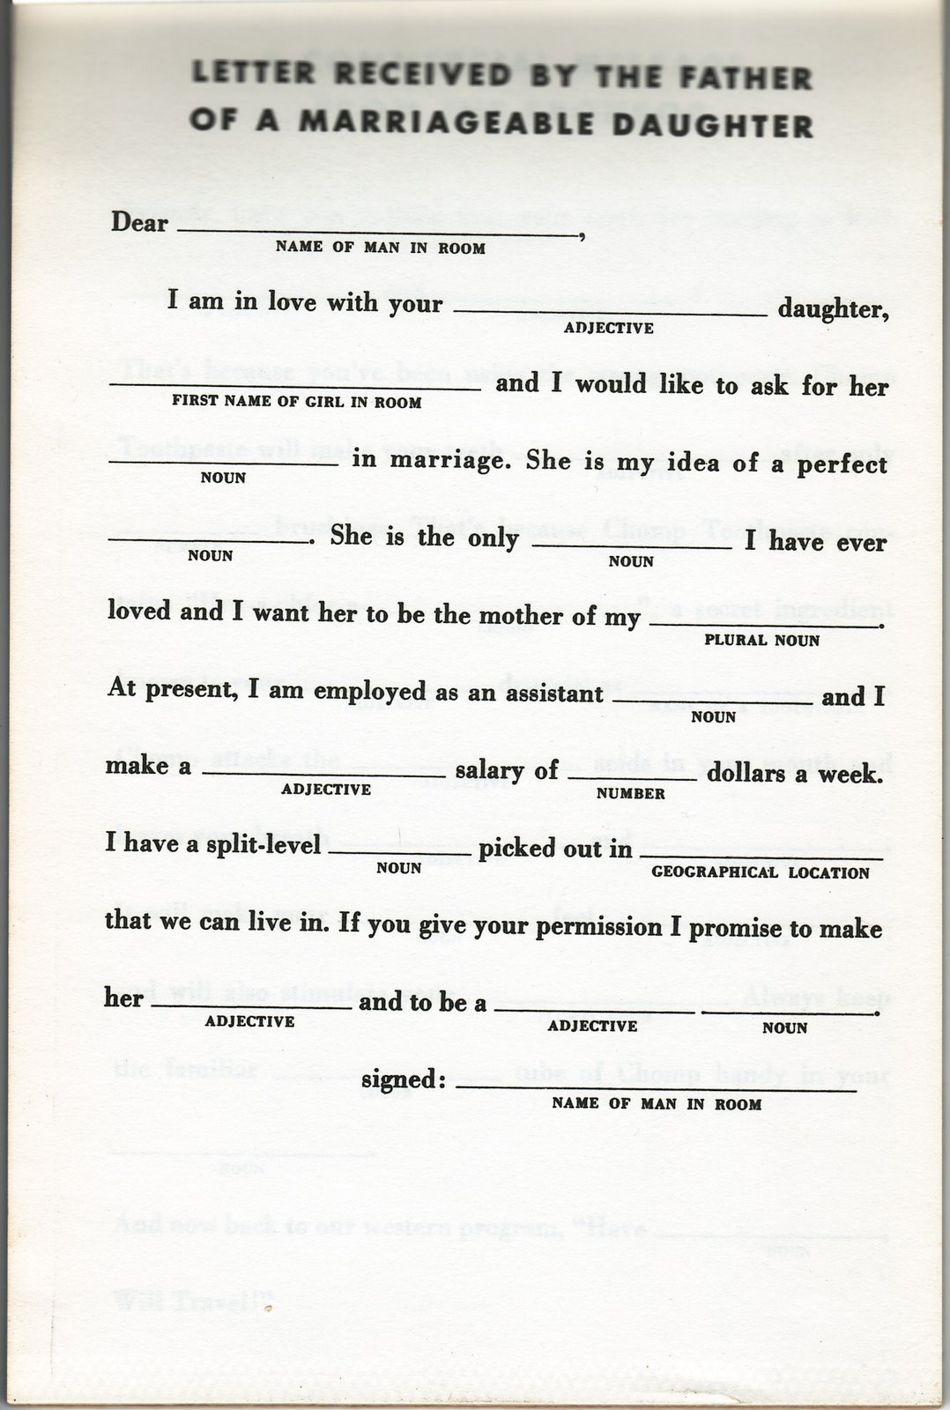
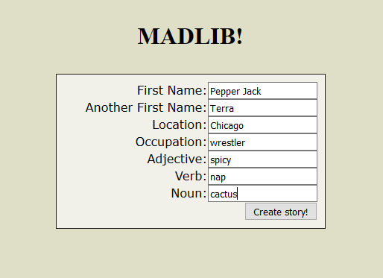
MADLIBS FUN
A game made up of words to create silly stories ☺
Project Coder: Amy Spruill
https://github.com/ksu-is/MadLib_Fun

